Slide 1
Where Were NAEP/TIMSS Scores From? Plausible Values & Direct Estimation Approaches
Ting Zhang, Ph.D.
Senior Researcher
NCME Workshop| April 2022

Slide 2
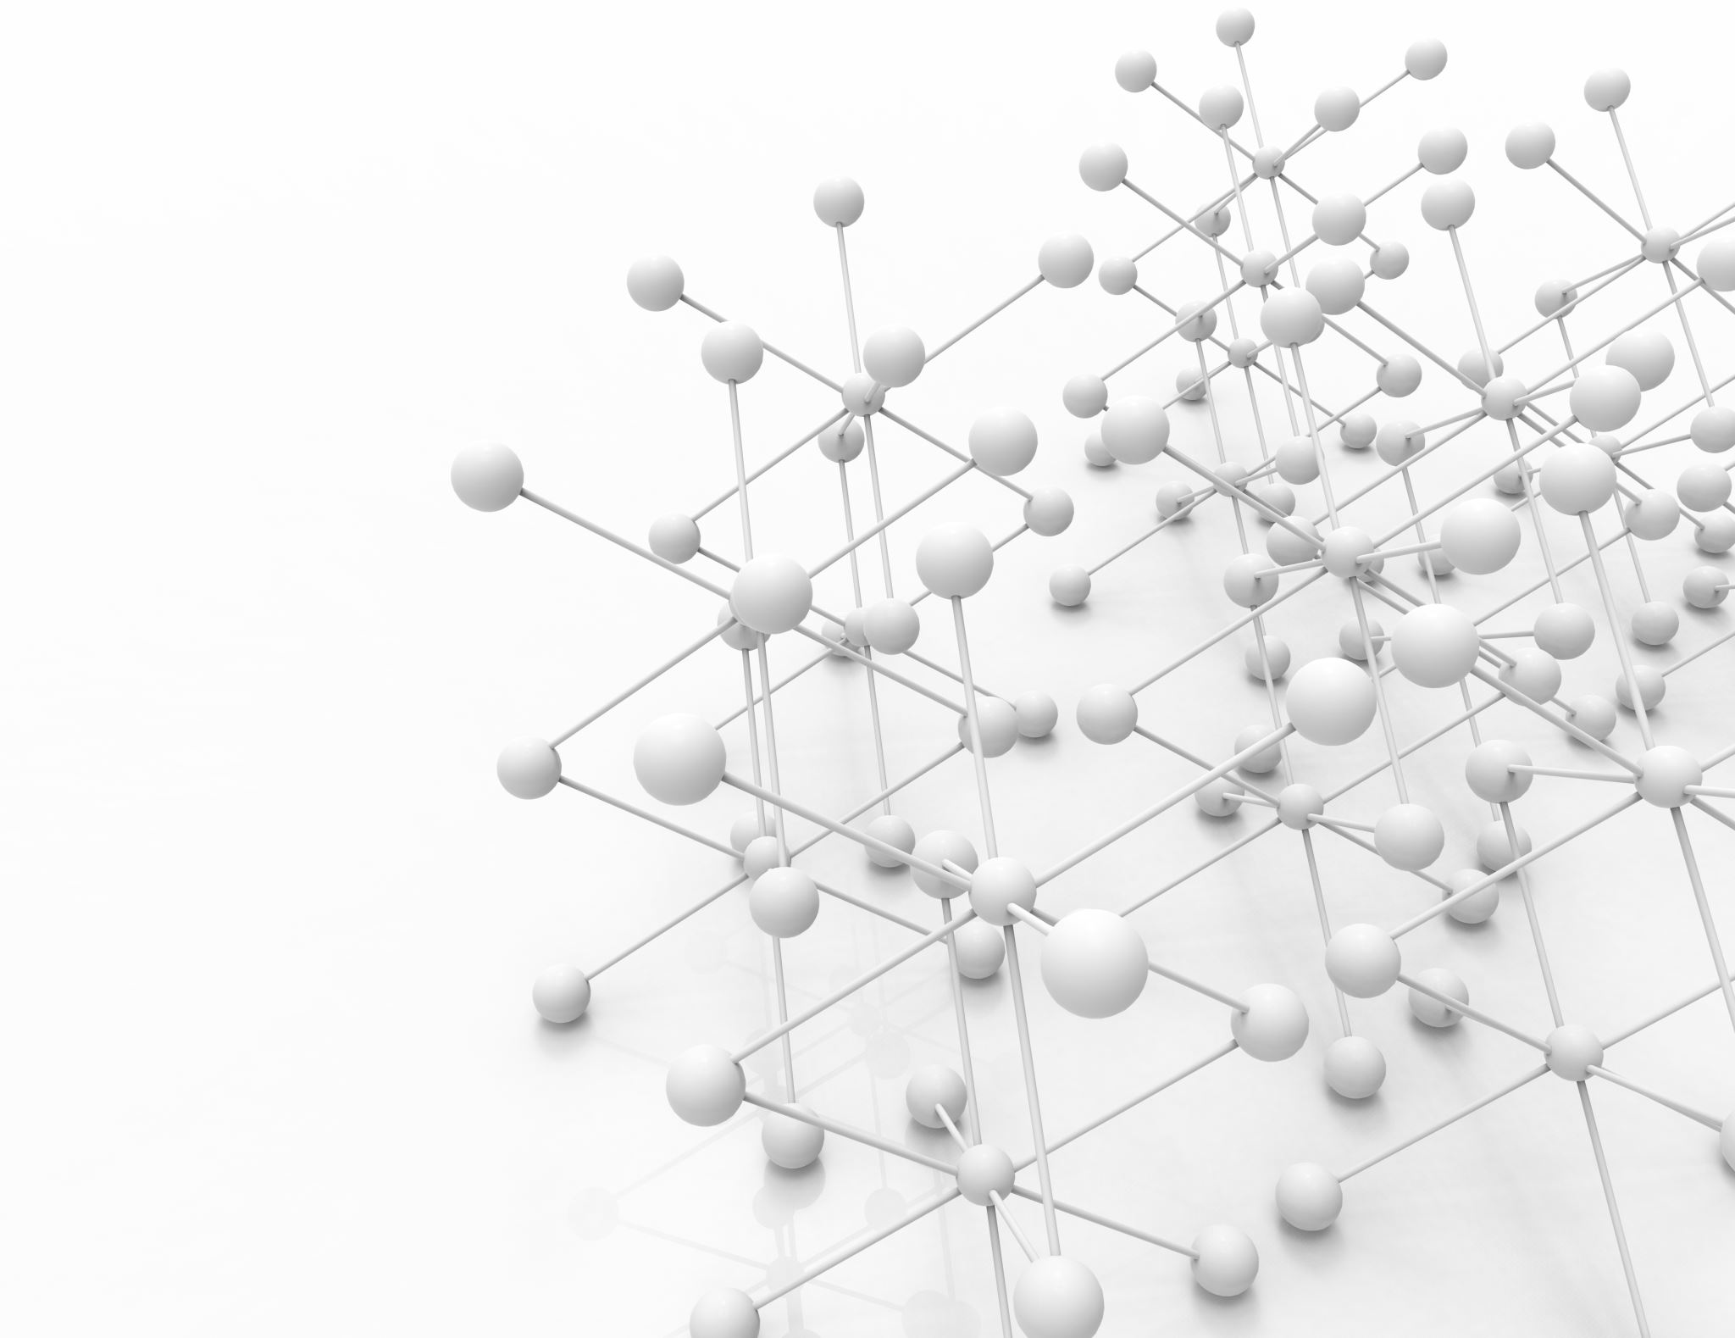
Overview
Psychometric models for NAEP/TIMSS data
The Direct Estimation Approach
The Plausible Values Approach

Slide 3

What are Plausible Values?
Proficiency estimates for an individual student, drawn at random from a conditional distribution of potential scale scores.
All available plausible values should be used when calculating summary statistics for groups of students
Notes:
In large scale assessments such as NAEP or TIMSS, when you try to study students’ achievement, you would notice that for each subject, instead of one achievement score for each sample student, the data file has multiple scores called plausible values assigned to each student. Have you wonder why having the plausible values, and how to use them in data analysis

Slide 4
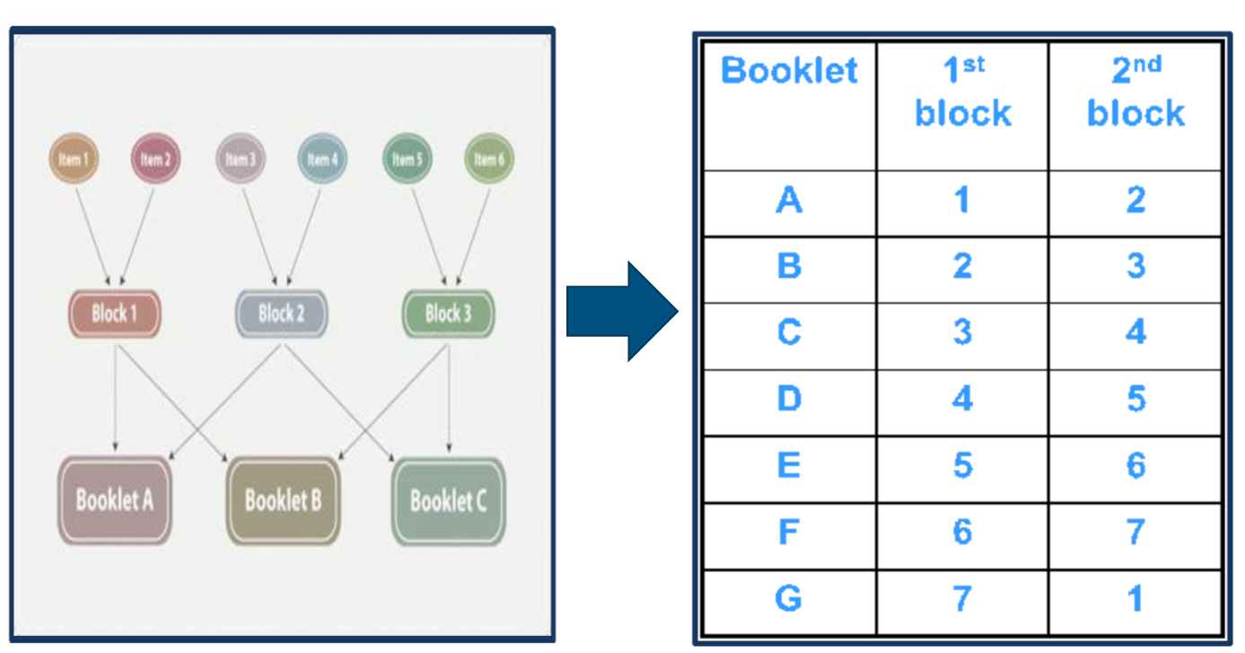
Why use Plausible Values?
Assessment designs!
Complex sampling design
Test design
Large scale assessments such as NAEP and TIMSS use a large item pool of test questions to provide comprehensive coverage of each subject domain.
To keep the burden of test-taking low and encourage school participation, each student is administered a small number of items.
But at the assessment level, all items are measured.
Notes:
The reason that large scale assessments such as NAEP and TIMSS uses plausible values is because of their unique test designs.
Unlike other assessments such as state assessments,
Several hundred questions are typically needed to reliably test the many specifications of the complex frameworks that guide NAEP assessments. However, administering the entire collection of cognitive questions to each student would be far too time consuming to be practical. Matrix sampling allows the assessment of an entire subject area within a reasonable amount of testing time, in most cases 50 minutes for paper-pencil administered assessments and 60 minutes for computer administered assessments. By this method, different portions from the entire pool of cognitive questions are printed in separate booklets or assembled separately on the computer and administered to different samples of students.

Slide 5
Advantages and trade-offs of the assessment design
Advantages
Cost efficient and avoids overburdening students and schools
Achieves broad coverage of the targeted content domain
Allows sufficiently precise estimates of proficiency distributions of the target population and sub-populations,
uses IRT and Multiple Imputations to create student scale scores – plausible values.
Trade-offs
Sampling error unique to complex sampling
Each student receives too few test questions to permit estimating an accurate scale score for that student.
Results in large sampling and measurement error and leads to inaccurate inference.

Slide 6
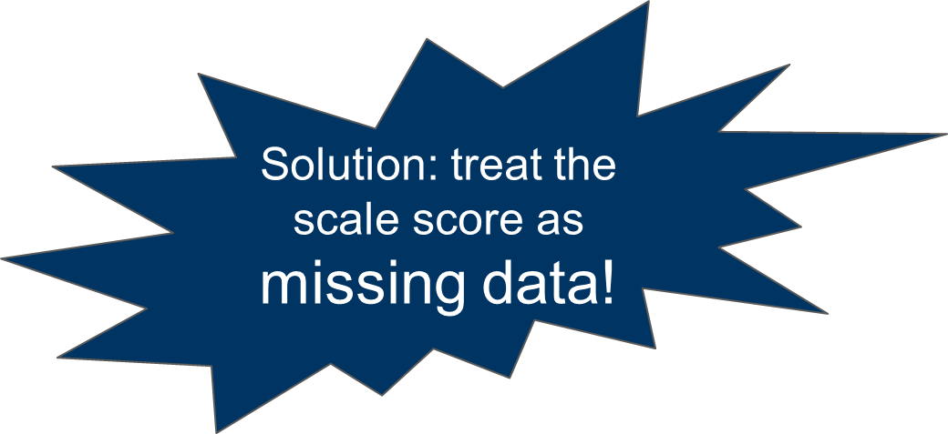
How can an assessment program work without accurate scores for individual students?
One way of taking the uncertainty associated with the estimates into account, and of obtaining unbiased group-level estimates, is to use multiple imputation to impute what we know about the students and obtain the distribution that represent a student’s proficiency.
Plausible values are based on student responses to the subset of items they receive and available background information (Mislevy, 1991).
Notes:
The solution that most large-scale assessments use is multiple imputation. It helps obtain unbiased group-level estimates such as means, regression coefficients, also it can better take the uncertainty, measurement error into account.

Slide 7
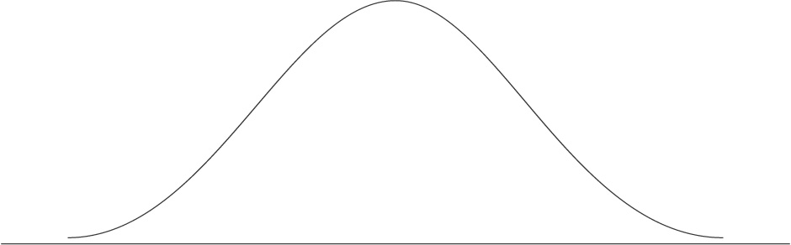
Ability Distribution and Plausible Values
Ability Distribution
PV2
PV4
PV1
PV5
PV3

Slide 8
How NAEP/TIMSS scores are generated? (von Davier, Gonzalez & Mislevy 2009)
The first stage
requires estimating IRT parameters for each cognitive question.
The second stage
results in latent regressions that imputing scale performance with all information in the student, teacher, and school questionnaires.
The third stage
combines the previous two stages.
The fourth stage
draws multiple plausible values from a posterior distribution.
Notes:
Imputation is performed in three stages. The first stage requires estimating IRT parameters for each cognitive question. The second stage results in MML estimation of a set of regression coefficients that capture the relationship between group score distributions and nearly all the information from the variables in the teacher, school, or SD/ELL questionnaires, as well as geographical, sample frame, and school record information. The third stage involves the imputation that is designed to reproduce the group-level results that could be obtained during the second stage.

Slide 9
1st stage: Item response theory (IRT)
Estimating IRT parameters for each cognitive question, and a likelihood function for proficiency.
Common IRT models used in large scale assessments
Dichotomous items: the two- or three-parameter logistics item response model
Polytomous items: the generalized partial credit model

Slide 10
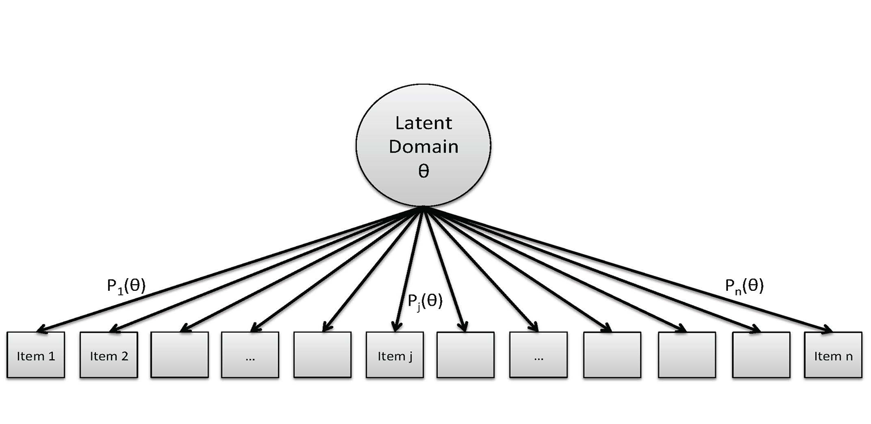
Item response theory (IRT)
We believe that students have a degree of skill in reading, math, science, etc., but we don’t know what that degree of skill is
Instead of measuring skill by summing the number of correct items (raw score), Item Response Theory (IRT) models the relationship of each item with the latent ability distribution θ.

Slide 11
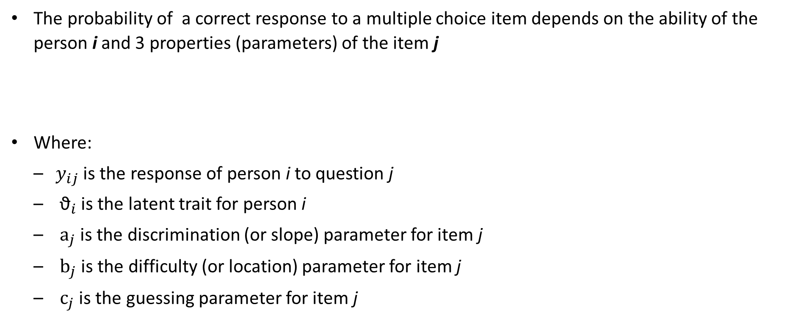
Three parameter (3PL) logistic model
The probability of a correct response to a multiple choice item depends on the ability of the person i and 3 properties (parameters) of the item j
Where:
$y_{ij}$ is the response of person i to question j
${\text{ϑ}}_{i}$ is the latent trait for person i
${\text{a}}_{j}$ is the discrimination (or slope) parameter for item j
${\text{b}}_{j}$ is the difficulty (or location) parameter for item j
${\text{c}}_{j}$ is the guessing parameter for item j

Slide 12
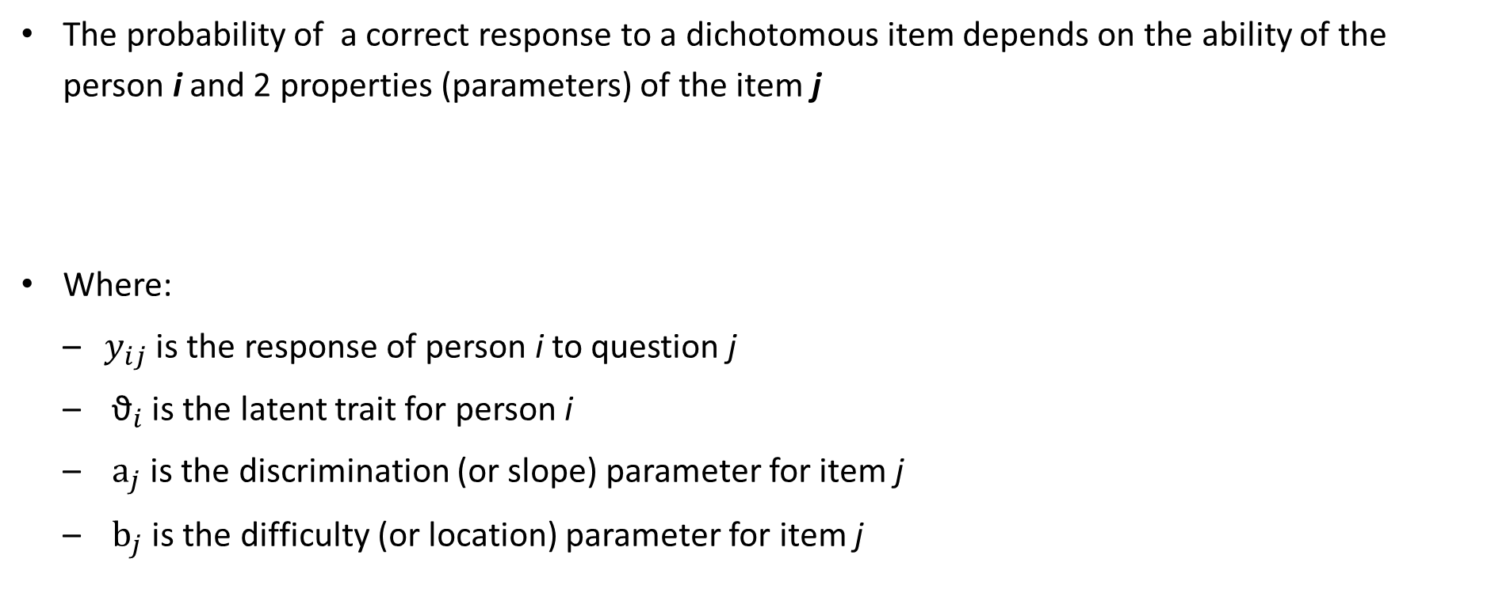
Two parameter (2PL) logistic model
The probability of a correct response to a dichotomous item depends on the ability of the person i and 2 properties (parameters) of the item j
Where:
$y_{ij}$ is the response of person i to question j
${\text{ϑ}}_{i}$ is the latent trait for person i
${\text{a}}_{j}$ is the discrimination (or slope) parameter for item j
${\text{b}}_{j}$ is the difficulty (or location) parameter for item j

Slide 13
Item Characteristic Curves Difficulty parameter
b= -0.45
Probability
Trait Level

Slide 14
Discrimination parameter
Probability
Trait Level

Slide 15
Guessing parameter
Probability
Trait Level

Slide 16
Generalized partial credit (GPC) model
The probability of getting a particular score on a constructed response item, e.g., a score of 2 in a writing task with a score scale 0 to 4, depends on the ability of the person i and properties of the item j
discrimination parameter
to or subtract from the base difficulty parameter

Slide 17
Category Response Curves Probability of score 0 for item j
Probability
Trait Level

Slide 18
Probability of score 0 and 1, each for item j
Probability
Trait Level

Slide 19
Probability of score 0, 1, and 2, each for item j
Probability
Trait Level

Slide 20
Probability of score 0, 1, 2, and 3, each for item j
Probability
Trait Level

Slide 21
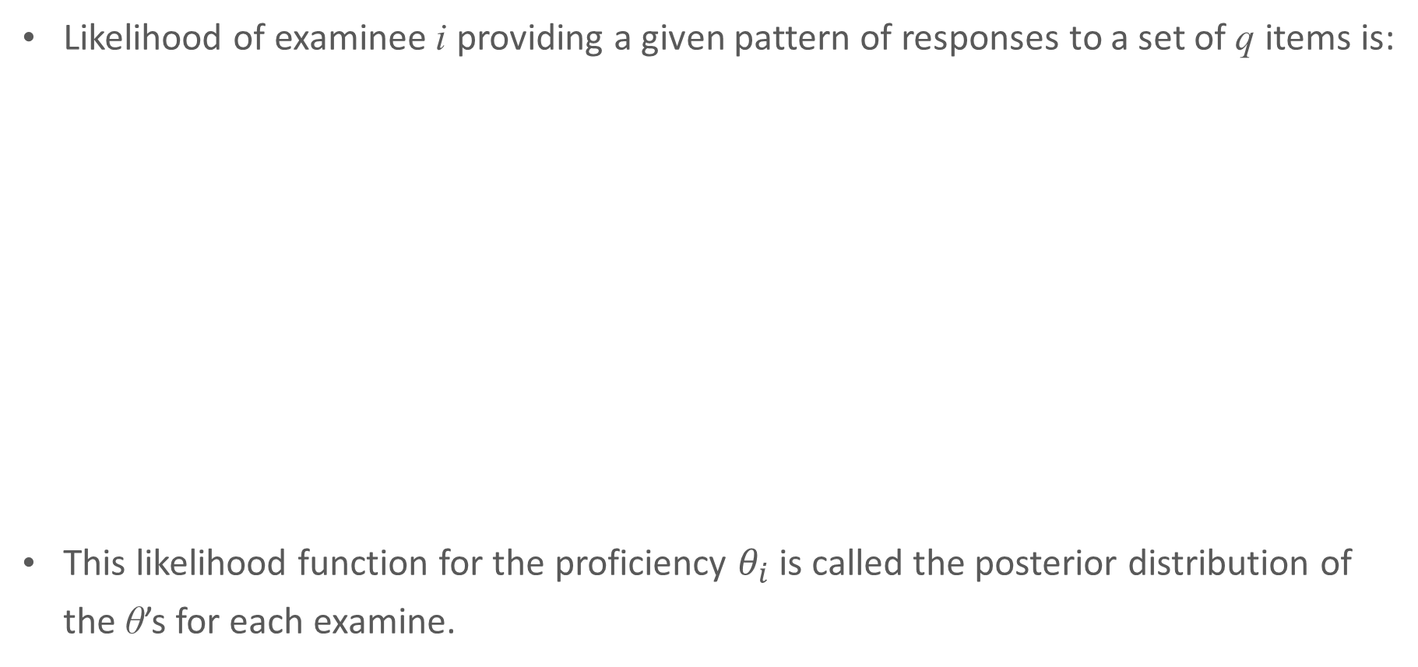
Likelihood of the pattern of answers from an examinee
Likelihood of examinee i providing a given pattern of responses to a set of q items is:
This likelihood function for the proficiency $θ_{i}$ is called the posterior distribution of the θ’s for each examine.

Slide 22

Example: Likelihood function based on six NAEP math items
Three 3PL items answered incorrectly (k = 0)
Two 3PL items answered correctly (k = 1)
One GPC item answered with partial credit (k = 1)
Notes:
At each point along the horizontal axis, the value of the item characteristic curves are multiplied together (and rescaled vertically for this graph)
For the purpose of this explanation, the likelihood function, shown in red, is approximated to be a normal distribution
The maximum value could be considered the student’s test score, if the curve were not so wide
Why don’t we stop here?
-3 -2 -1 0 1 2 3 4

Slide 23

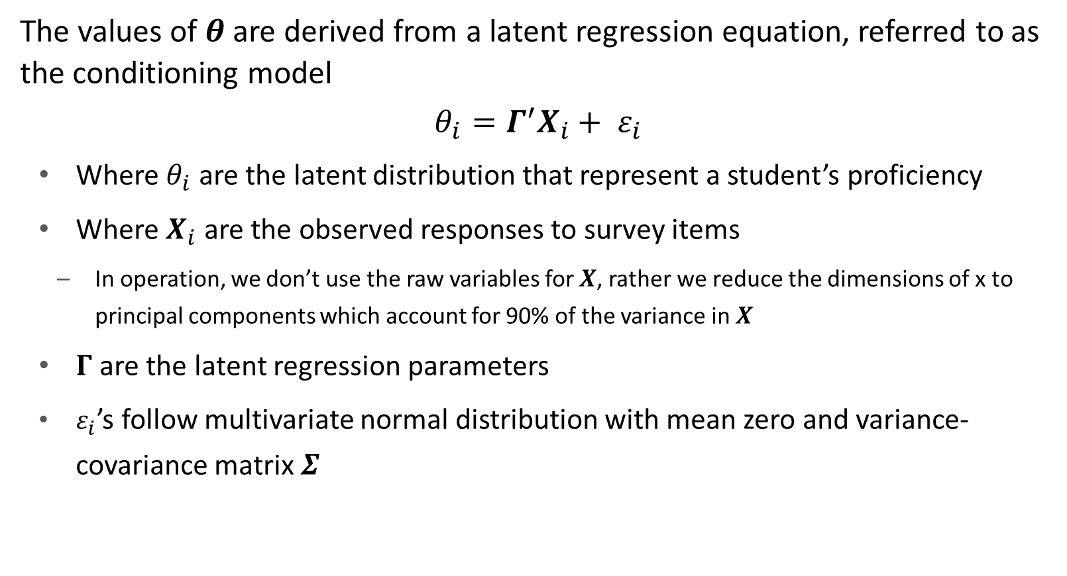
2nd stage: Conditioning model (population model )
The values of $θ$ are derived from a latent regression equation, referred to as the conditioning model
${θ_{i}=Γ}^{′}X_{i}+ ε_{i}$
Where $θ_{i}$ are the latent distribution that represent a student’s proficiency
Where $X_{i}$ are the observed responses to survey items
In operation, we don’t use the raw variables for $X$, rather we reduce the dimensions of x to principal components which account for 90% of the variance in $X$
$Γ$are the latent regression parameters
$ε_{i}$’s follow multivariate normal distribution with mean zero and variance-covariance matrix $Σ$

Slide 24
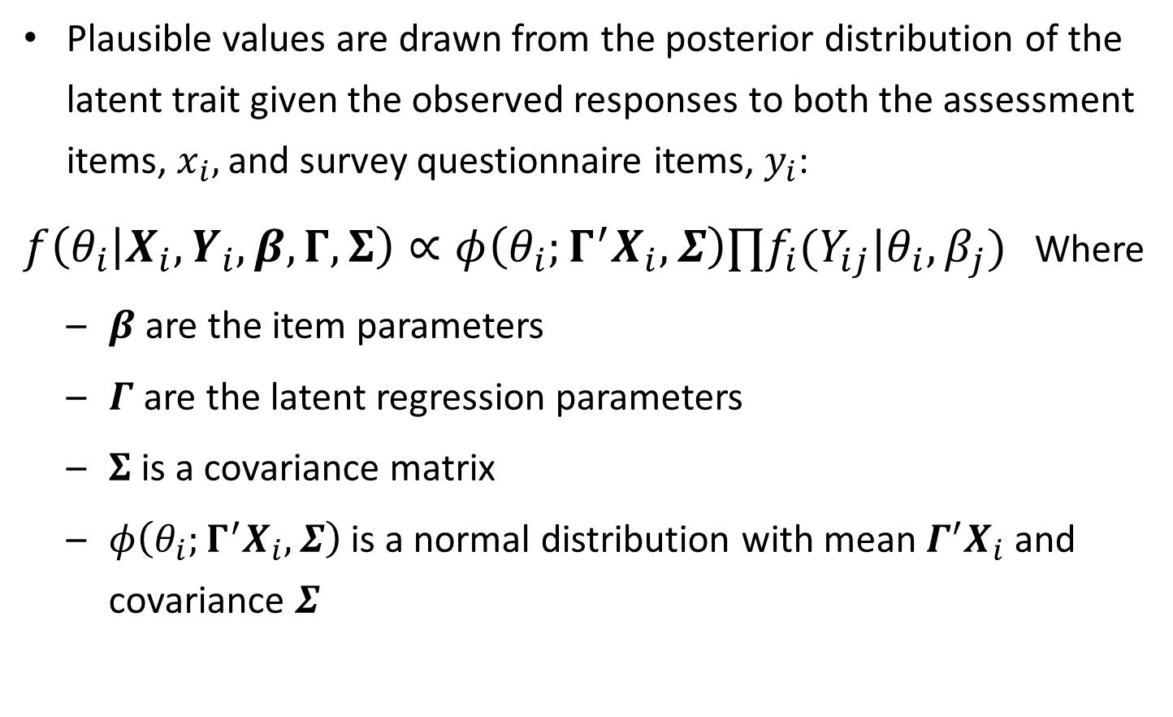
3rd stage: Final model
Likelihood function based on the item responses
Plausible values are drawn from the posterior distribution of the latent trait given the observed responses to both the assessment items, $x_{i},$ and survey questionnaire items, $y_{i}$:
$f\left(θ_{i} | X_{i},Y_{i},β,Γ,Σ\right)∝φ\left(θ_{i};Γ^{′}X_{i},Σ\right)∏f_{i}(Y_{ij}|θ_{i},β_{j})$ Where
$β$are the item parameters
$Γ$ are the latent regression parameters
$Σ$is a covariance matrix
$φ\left(θ_{i};Γ^{′}X_{i},Σ\right)$is a normal distribution with mean $Γ^{′}X_{i}$ and covariance $Σ$
Latent regression

Slide 25
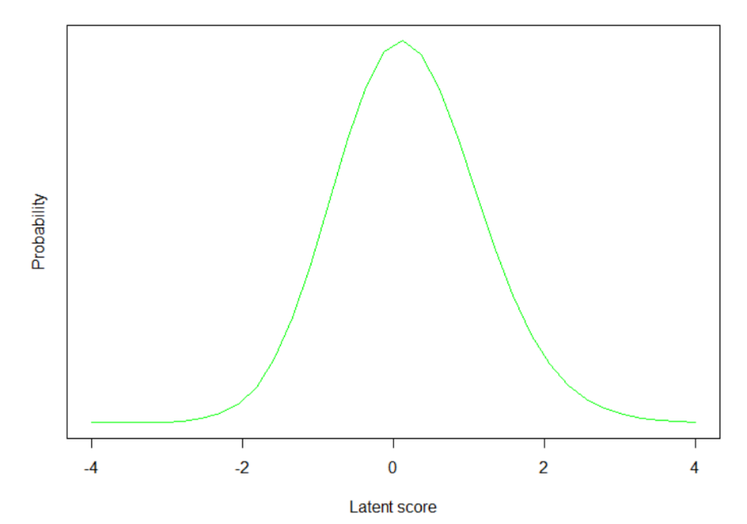
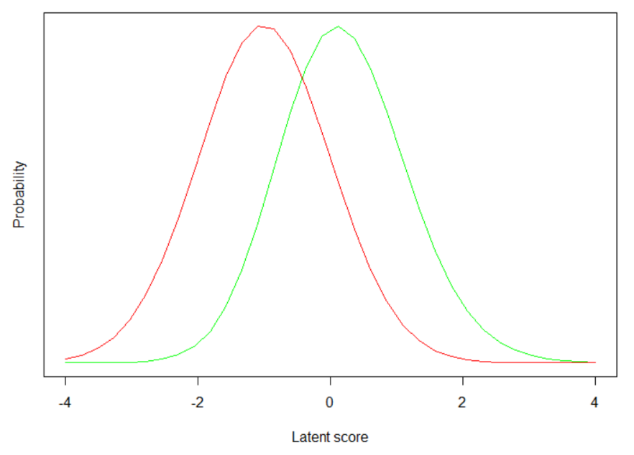
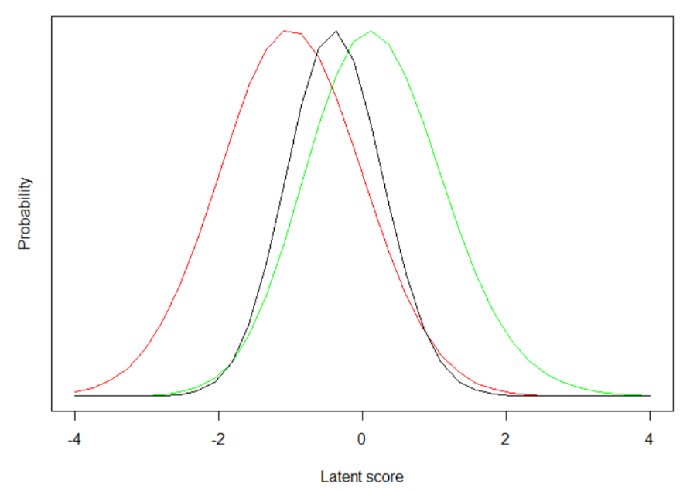
Likelihood distribution from the final model
green line = student likelihood, red line = prior/conditioning model, black line = overall (convolution of both)

Slide 26
The Direct Estimation approach
It is the 3rd stage final model
Through the final model, obtain regression estimates for conditioned subgroups/contextual variables
Weights and sampling design variables (e.g., PSU and STRATA) applied
Taylor series method is used for variance estimation

Slide 27
The Plausible Values approach
Draw multiple potential values from the posterior distribution from the 3rd stage final model.
Rubin’s multiple imputation method need to be used to calculate the measurement error (imputation error) and sampling error

Slide 28

Pro and con of the PV approach
Already available in the datasets. Existing statical packages to handle them.
You can only use covariates that were included in the conditioning model for PVs
Adding new variable to analytical model may bias the results.
Computation intensive. Have to rely on testing companies and special internal software.

Slide 29

Advantages of the Direct Estimation approach
Allows to add covariates (e.g., PC or external variables) without biasing the analytical results
Allow to analyze NAEP/TIMSS data properly with selected important covariates and your variables of interest

Slide 30


Why use Dire and EdSurvey?
Dire offers direct estimation and draw PVs functions. Good alternative for AM.
EdSurvey acts as an interface to Dire, streamlines all procedures required for DE:
Makes item adjustments made by NCES
Allows users to use new PVs in the same way NCES PVs were used--all EdSurvey functions are available for the new PVs!
Implements scoring, IRT parameters, scaling information automatedly
Takes care of complex design features such as weighting and variance estimation behind the scene

Slide 31
Reference
Mislevy, R. (1991). Randomization-based inference about latent variables from complex samples. Psychometrika, 56, 177–196.
Rubin, D. (1987). Multiple imputation for nonresponse in sample surveys. New York: John Wiley.
Rutkowski, L., Gonzalez, E., Joncas, M., & von Davier, M. (2010). International large-scale assessment data: Issues in secondary analysis and reporting. Educational Researcher, 39(2), 142-151.
von Davier, M., Gonzalez, E., & Mislevy, R. (2009). Plausible values: What are they and why do we need them? IERI Monograph Series: Issues and Methodologies in Large-Scale Assessments, 2, 9–36.
von Davier, M., & Sinharay, S. (2014). Analytics in international large-scale assessments: Item response theory and population models. In L. Rutkowski, M. von Davier, & D. Rutkowski (Eds.), Handbook of international large-scale assessment (pp. 155–174). Boca Raton, FL: Taylor & Francis.

Slide 32
Ting Zhang
Senior Psychometrician / Statistician
202.403.6646
tzhang@air.org

Slide 33
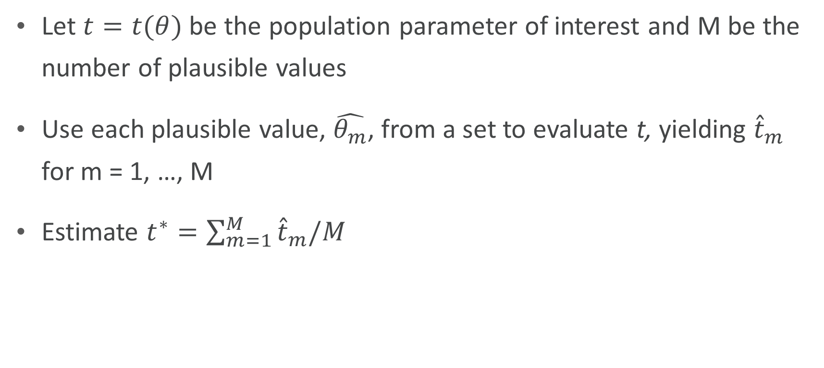
How do we analyze Plausible Values?
Let $t=t(θ)$ be the population parameter of interest and M be the number of plausible values
Use each plausible value, $\hat{θ_{m}}$, from a set to evaluate t, yielding ${\hat{t}}_{m}$ for m = 1, …, M
Estimate $t^{∗}=\sum_{m=1}^{M}{{\hat{t}}_{m}/M}$

Slide 34
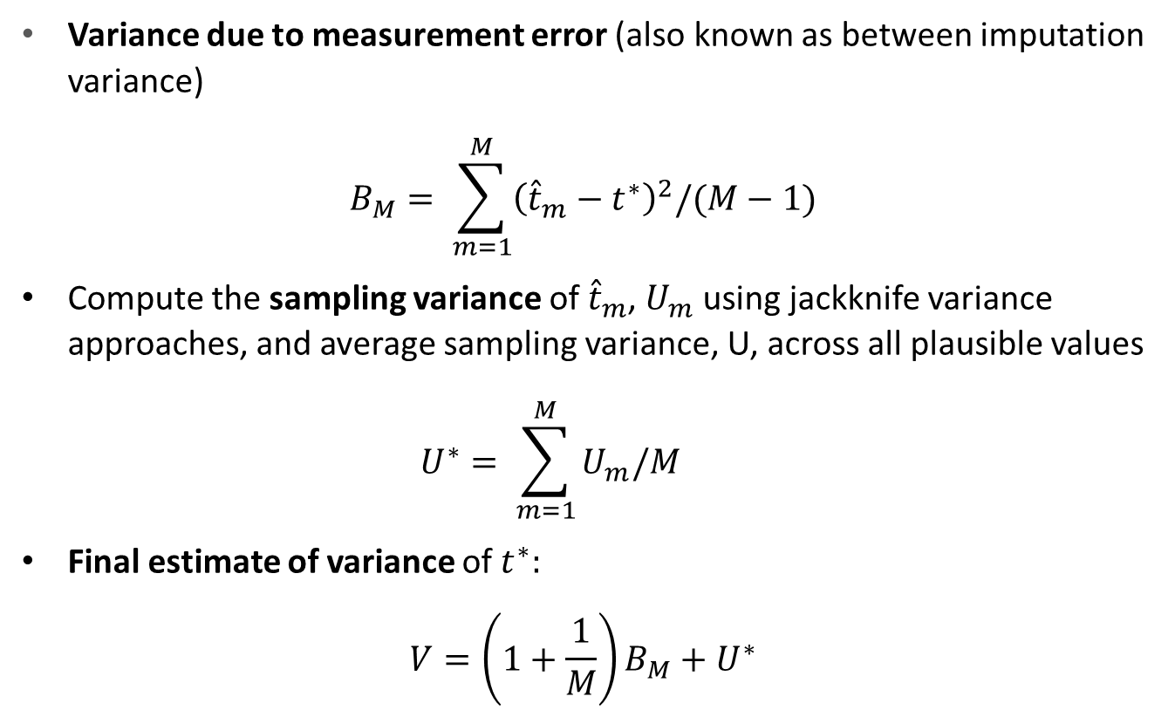
Variance estimation from Plausible Values
Variance due to measurement error (also known as between imputation variance)
$$B_{M}= \sum_{m=1}^{M}{{\left({\hat{t}}_{m}−t^{∗}\right)}^{2}/(M}−1)$$
Compute the sampling variance of ${\hat{t}}_{m}$, $U_{m}$ using jackknife variance approaches, and average sampling variance, U, across all plausible values
$$U^{∗}= \sum_{m=1}^{M}{U_{m}/M}$$
Final estimate of variance of $t^{∗}:$
$$V=\left(1+\frac{1}{M}\right)B_{M}+U^{∗}$$
measurement variance
+ sampling variance

